Slide 1
Micro Mayhem
Computer Games Design Project

Slide 2
Who are we?
Alasdair Hendry – Majority of coding
Ross McDade – Majority of documentation
Team Name – MegaStorm Games

Slide 3
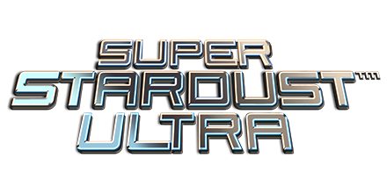
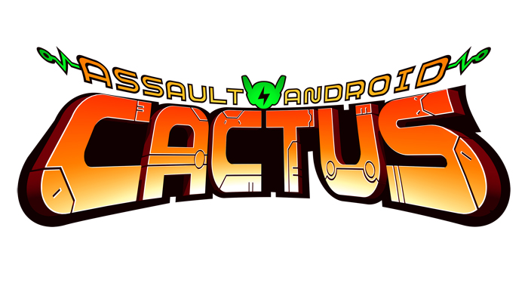
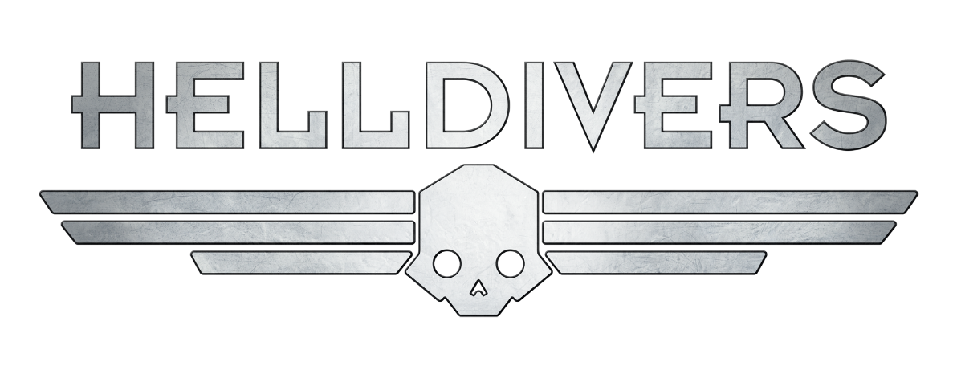
Game Summary
Genre – Twin Stick Shooter
Isometric, 3D Graphics
Similar games: - Super Stardust Ultra - Assault Android Cactus - Helldivers - Hotline Miami

Slide 4
Sketches/Art
Scan in artwork and sketches

Slide 5
Mood Board
Mood board images go here

Slide 6
Level Design
Prototype will have one level
Inside of a human body
Multiple spawn points for enemies
Sketch for level
Screenshot of level from game

Slide 7
Level Design - Progression
Tutorial
Level 1 – Melee Enemy Types
Level 2 – Melee & Martyr Enemy Types
Level 3 – Melee, Martyr & Shooter Enemy Types
Level 4 – Melee, Martyr, Shooter & Brute Enemy Types

